Slide 1
Protection of intangible cultural heritage in Sicily
Giacomo Pace Gravina
University OF messina, italy

Slide 2
Sicily, Italy, Mediterranean Sea

Slide 3
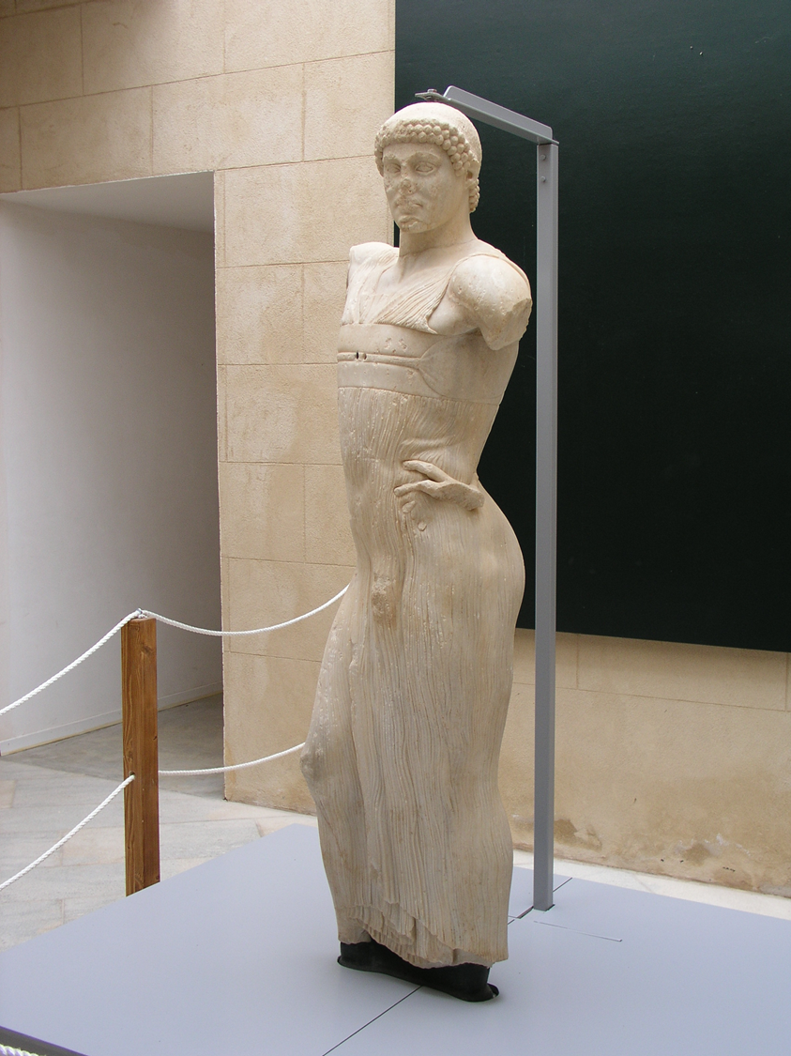
Cultural Heritage of Sicily: an inexhaustible Mine
Mosaics of the Room of King Roger, Palermo, 12th Century
The Young of Mothya, 5th Century b.C.

Slide 4
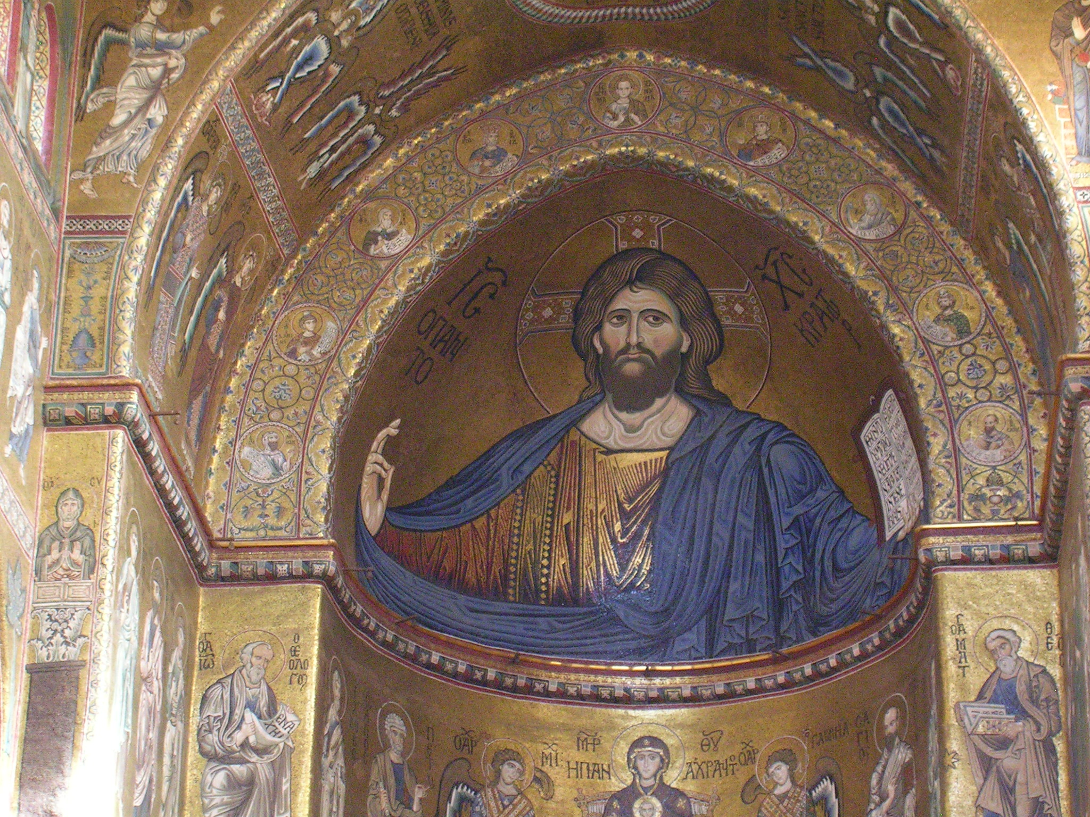
protection strategies: the importance of UNESCO recognition
Cathedral of Monreale, Mosaic of Pantocrator
12th Century

Slide 5
In Sicily the highest percentage of UNESCO Sites
UNESCO World Heritage:
In the World: 1092 Sites
In Italy: 53
In Sicily: 11

Slide 6
Only Sicily: 7 Sites (tangible)
Palermo Arab-Norman and the Cathedrals of Cefalù and Monreale
Archaeological Area of Agrigento (Valley of the Temples)
Mount Etna
Aeolian Islands
The late Baroque cities of the Val di Noto
Roman Villa of the Casale
Syracuse and the Necropolis of Pantalica

Slide 7
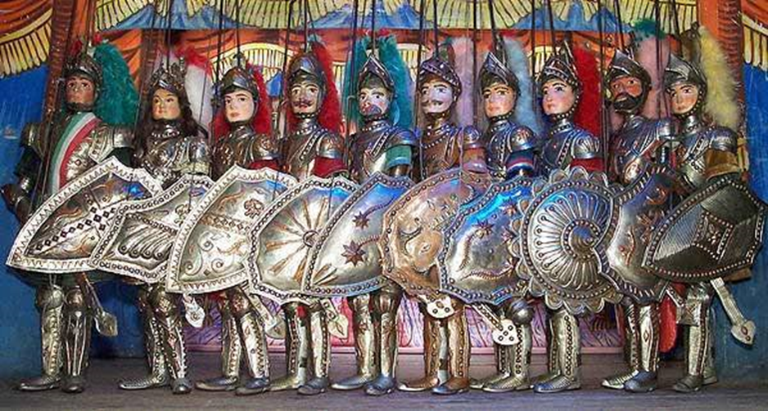
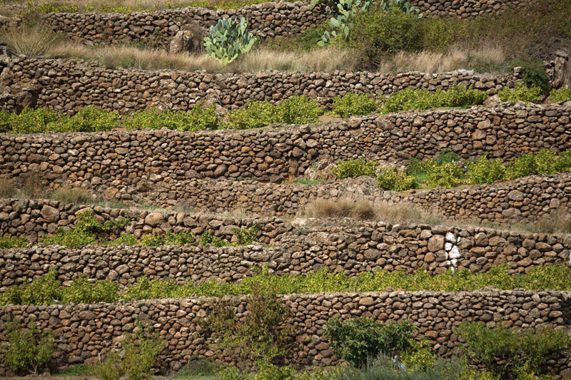
… and 4 (intangible)
L’«Opera dei Pupi»
The sapling vine of Pantelleria
Mediterranean diet (transnational)
The art of dry stone walls (transnational)
Opera dei Pupi
Pantelleria, dry stone walls

Slide 8
Monumental Heritage of Ancient Sicily: the Greek monuments
Agrigento, Concordia Temple
5th Century b.C.

Slide 9
…the Roman age
Piazza Armerina
Roman Villa of Casale
4th Century a.C.

Slide 10
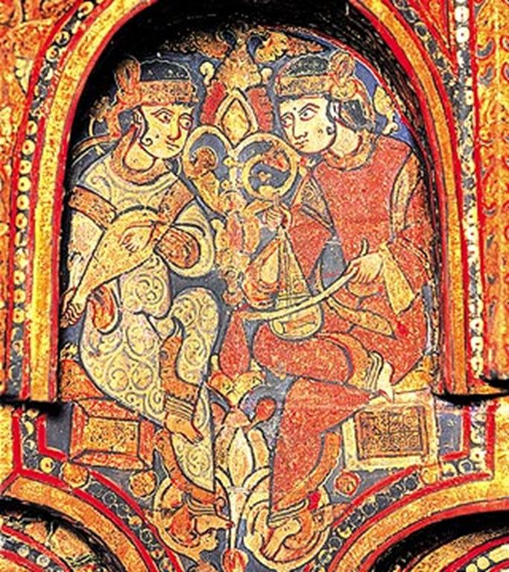
the Byzantine and the Arabs
Monreale, Cathedral,
Mosaic of miraculous fishing
12th Century

Slide 11
… Sicily in Middle Age: the Normans
Church of San Giovanni degli Eremiti, Palermo, 12th Century

Slide 12
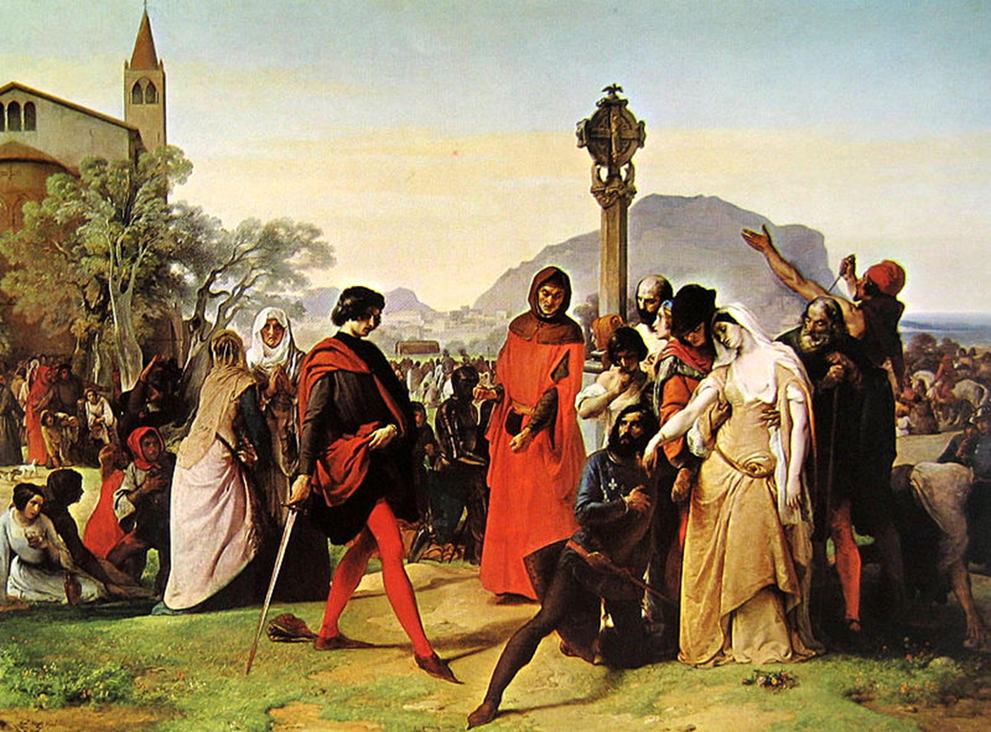
the Swabians and the Angevins
Catania, Ursino Castle,13th Century

Slide 13
The Sicily of 15th Century
F. Laurana, The Queen Eleonora of Aragona

Slide 14
the Spanish age and the Baroque

Slide 15
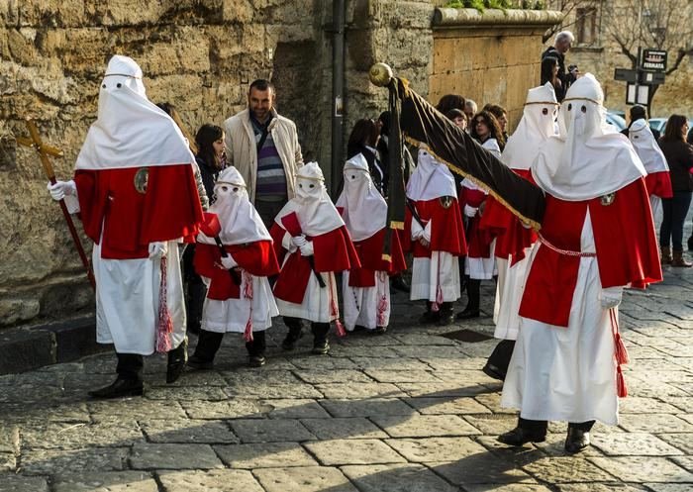
The intangible Heritage
this stratification of civilizations, as well as many important monuments, has also generated an intangible heritage, made of social practices, civil and religious festivals, traditional cuisine, popular music, and so on.

Slide 16
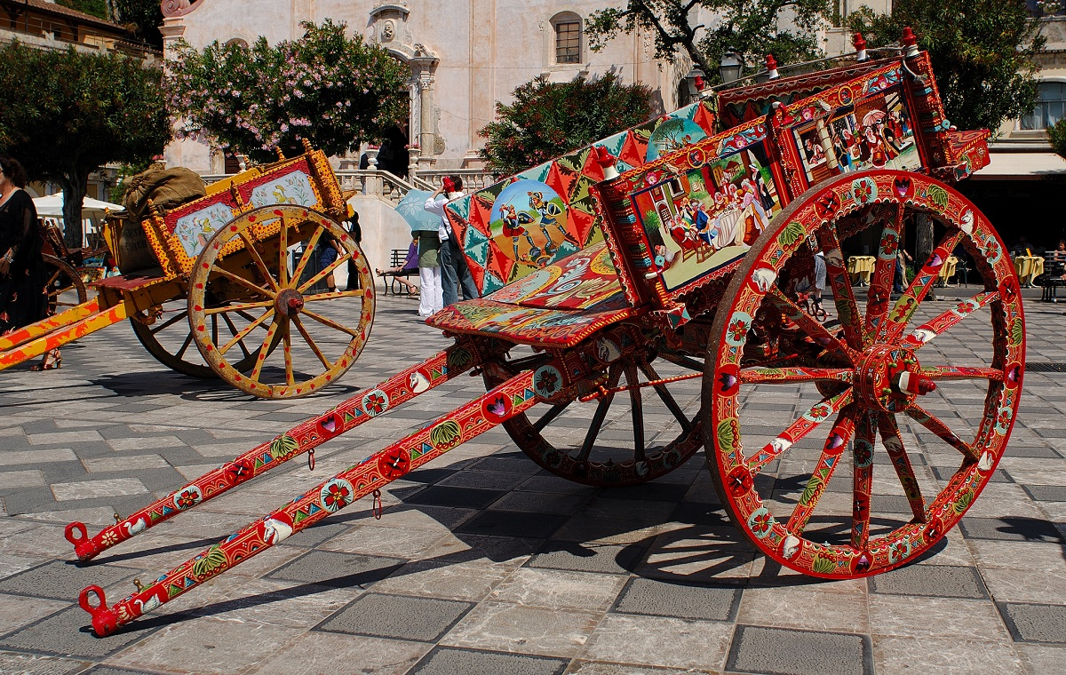
Convention for Safeguarding of the Intangible Cultural Heritage, approved by UNESCO on 17 October 2003
“Intangible Cultural Heritage means the practices, representations, expressions, knowledge, and skills – as well as the instruments, objects, artifacts and cultural spaces associated therewith – that communities, groups and, in some cases, individuals recognize as part of their cultural heritage. This intangible cultural heritage, transmitted from generation to generation, is constantly recreated by communities and groups in response to their environment, their interaction with nature and their history, and provides them with a sense of identity and continuity, thus promoting respect for cultural diversity and human creativity. For the purposes of this Convention, consideration will be given solely to such intangible cultural heritage as is compatible with existing international human rights instruments, as well as with the requirements of mutual respect among communities, groups and individuals, and of sustainable development”.
«Carretti siciliani»

Slide 17
The Faro Convention or the Council of Europe Framework Convention on the Value of Cultural Heritage for Society, 2005
The Faro Convention establishes rights and responsibilities to and for cultural heritage, explicitly in the context of Article 27 of the United Nations Declaration of Human Rights which guarantees the right "freely to participate in the cultural life of the community“.
Article 1 states that "rights relating to cultural heritage are inherent in the right to participate in cultural life.“
Article 4 states that "everyone... has the right to benefit from the cultural heritage and to contribute towards its enrichment."
The convention also focuses on promoting sustainability, access and the use of digital technology in the context of cultural heritage.

Slide 18
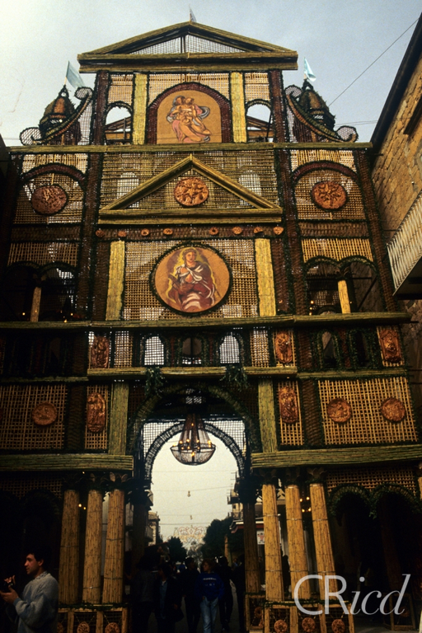
In Sicily: 2005, institution of the Register of Intangible Heritage and of the Regional Program of Intangible Heritage, renewed in 2014
Implementation of the 2003 UNESCO Convention
To establish the Register of Intangible Heritage of the Sicilian Region
(Bread Bows of San Biagio Platani)

Slide 19
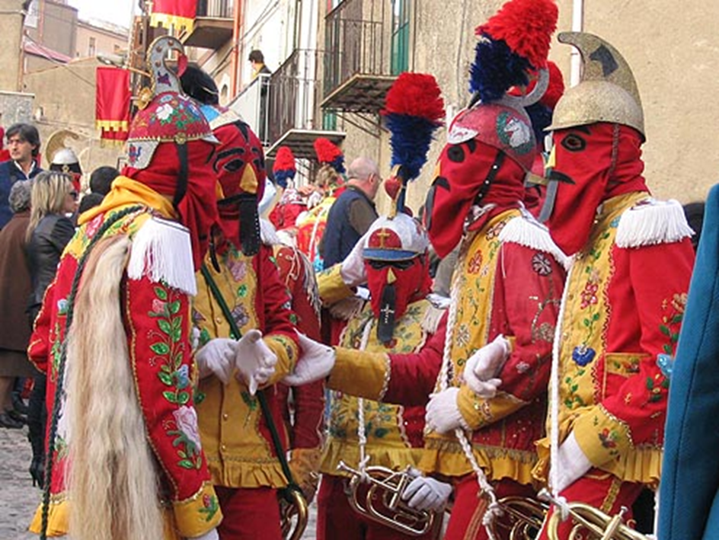
Divided into 6 books:
the Book of Celebrations, Festivals and Ritual Practices
the Book of Crafts, Knowledge and Techniques
the Book of the Dialects, the Parlance and the Jargons
the Book of Expressive Practices and Oral Repertoires
the Book of Living Human Treasures
the Book of Symbolic Spaces

Slide 20
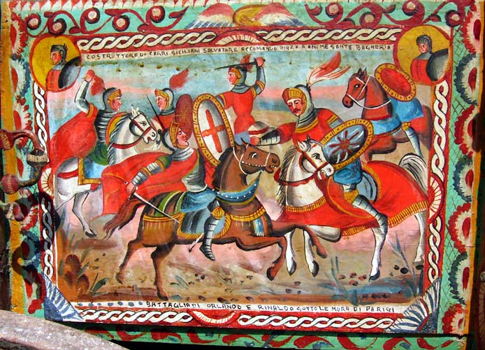
Regional Program of Intangible Heritage 225 elements have been registered since the establishment of the Register
Side part of «Carretto siciliano»

Slide 21
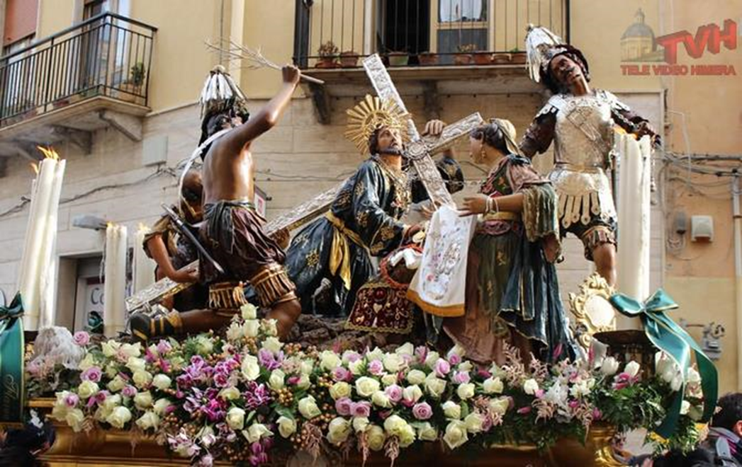
Book of Celebrations, Feasts and Ritual Practices
Where to inscribe the rites, ceremonies and popular manifestations associated with religiosity, productive cycles, entertainment and other moments that arise as historical-cultural traits characterizing the life of a community
(Procession of the Mysteries, Caltanissetta)

Slide 22
Book of Trades, Knowledge and Techniques
Where to register the ergological practices related to the history and traditions of the communities and the knowledge related to the management of the territory and the representation of natural and cosmic cycles
(Traditional costumes of Piana degli Albanesi)

Slide 23
Tradition of small clay statues of Caltagirone
Bongiovanni Vaccaro, The King Roger II of Sicily, 19th Century

Slide 24
Traditional Sicilian cookery
The «Cassata», typical easter cake

Slide 25
The «Cannoli»

Slide 26
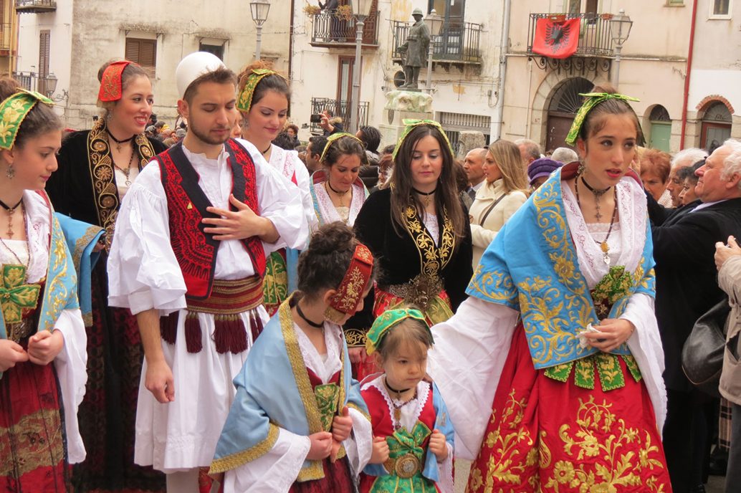
Book of Dialects and Jargons
Where to record those phenomena of linguistic communication that are the result of particular historical-cultural events or the expression of specific socio-cultural groups
(The Arbereshe language,
originally from Albania)

Slide 27
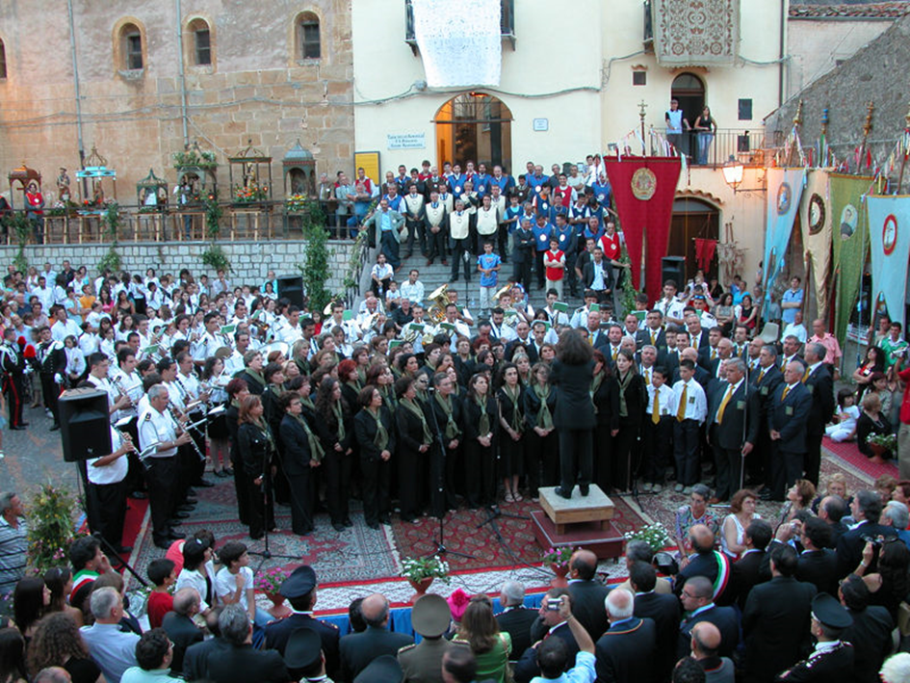
Book of Expressive Practices and Oral Repertoires
Where to enter the musical, dance, dramatic, verbal and playful traditions transmitted within historically stratified community processing dynamics
The “Frottole”of Isnello

Slide 28
Lamentation of Holy Week, Mussomeli

Slide 29
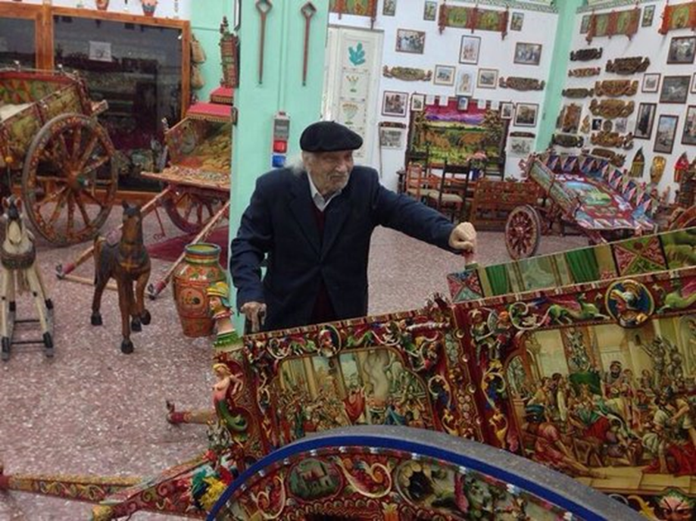
Book of Living Human Treasures
Where to register those individuals, the collectivities, the groups that present themselves as sole holders or particularly qualified in technical, ritual-ceremonial, linguistic or expressive knowledge referable to historical-cultural processes of "long duration“
(Domenico Di Mauro, Master carter)

Slide 30
Giacomo Alessi pottery artist

Slide 31
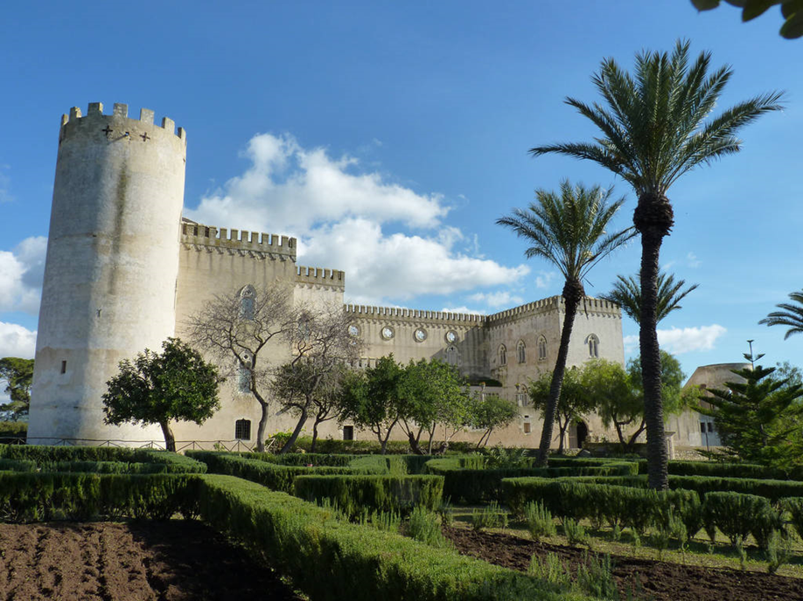
Book of Symbolic Spaces
Where to enter the spaces that have recorded such events as to generate dynamics of collective memories, symbolic production or which arise as historically identified socio-cultural scenarios
Cinema locations - Donnafugata Castle, Ragusa

Slide 32
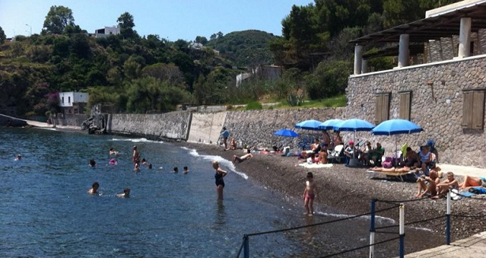
Beach of Portinente, Lipari

Slide 33
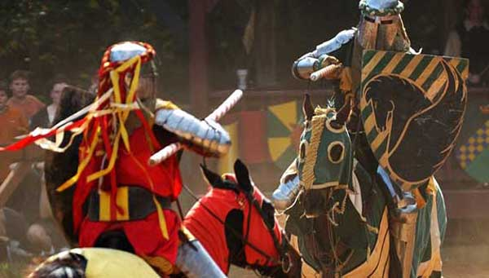
In this way is possible to preserve many manifestations of Sicilian culture, which risked disappearing due to globalization
Tournament of Ventimiglia, Geraci siculo

Slide 34
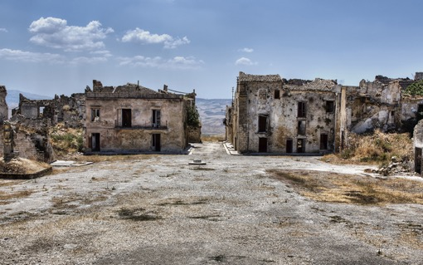
And avoid depopulation of the internal areas of the island
Belice

Slide 35
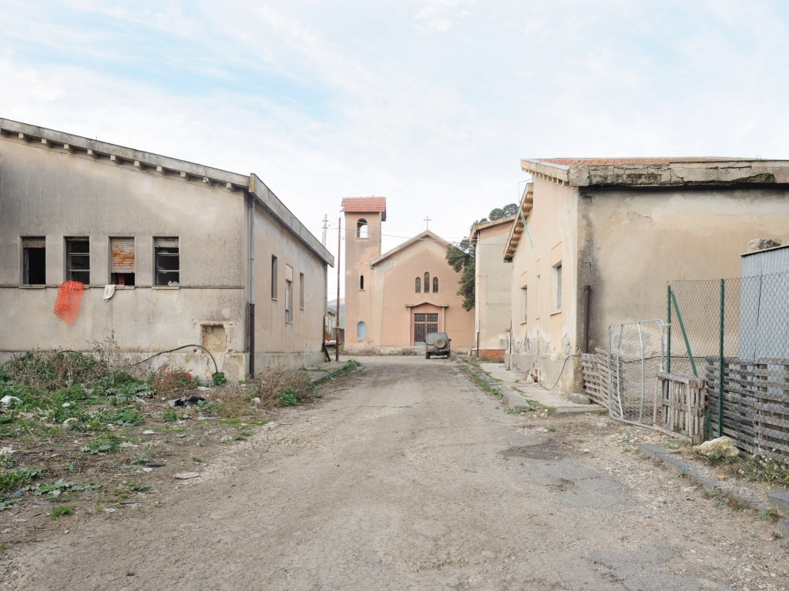
and of small urban centers
Borgo Lupo

Slide 36
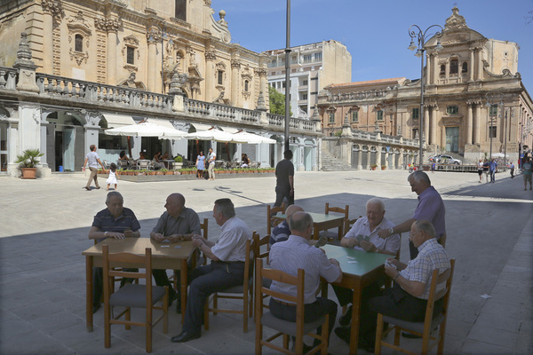
It is a Work in progress
Work that continues through processes of interaction with local communities
Ragusa, Piazza San Giovanni

Slide 37
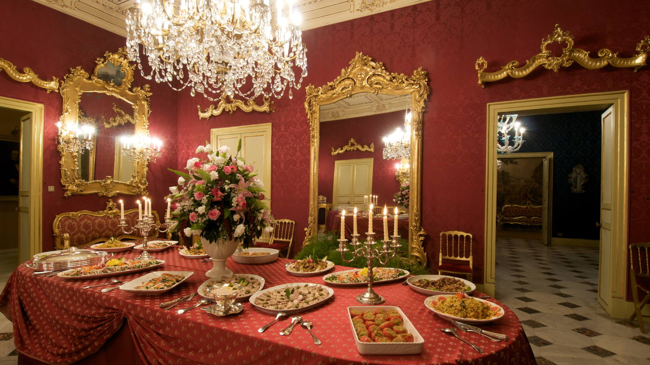
Local Communities can propose further inscriptions of other elements of the intangible heritage
The aristocratic cultural heritage

Slide 38
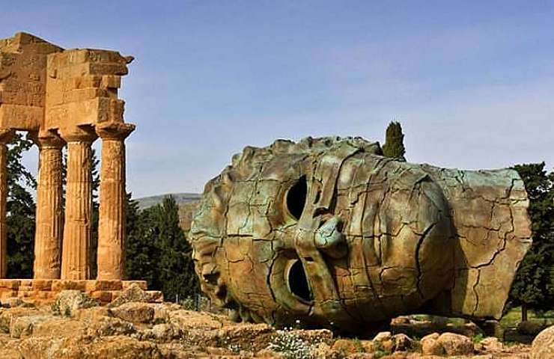
To extending the range of action of the protection of Memory
Igor Mitoraj sculpture, Valley of the Temples, Agrigento

