Slide 1
Garuwanga: Forming a Competent Authority to protect Indigenous Knowledge Natalie Stoianoff, Fiona Martin, Andrew Mowbray
Indigenous Knowledge Forum 2019
UTS Faculty of Law, Sydney 12-13 June 2019

Slide 2
Acknowledgement
We acknowledge and honour the Aboriginal and Torres Strait Islander Peoples of Australia, the First Peoples of this nation. We pay our respects to their Elders, past, present and future and we acknowledge them as the traditional custodians of their traditional lands, waters and knowledge.

Slide 3
Who we are and what we do
Introduction of Research Team members.
The Indigenous Knowledge Forum began in 2012.
The aim is to work out how Indigenous Knowledge can be protected in Australia for the benefit of Aboriginal and Torres Strait Islander Peoples.
In 2014 the Forum consulted with Indigenous communities and identified important issues relating to how to protect Indigenous Knowledge.
The Forum has hosted three conferences where ideas have been exchanged with people from around Australia and around the world.
IKF2

Slide 4
The Garuwanga Project
The Garuwanga Project is an Indigenous Knowledge Forum project funded under an Australian Research Council Linkage Grant that started in 2016.
The Garuwanga Project aims to:
identify and evaluate a variety of legal governance structures for a Competent Authority suitable for administering an Indigenous Knowledge protection regime
facilitate Aboriginal Community engagement in making that determination
recommend a type of Competent Authority structure based on what is important to Aboriginal Communities and how such a Competent Authority should operate
The Project Team has Partner Investigators representing 4 Aboriginal Partner Organisations and 3 Chief Investigators representing 2 Australian Universities.

Slide 5
Key questions for the Garuwanga Project
expectations of the functions and powers of the Competent Authority; and
Aboriginal laws and customs considered relevant by Aboriginal Partner Investigators and other Aboriginal members of the Project;
suitability to the domestic legal and regulatory context.

Slide 6
What is a Competent Authority and why do we need one?
A ‘Competent Authority’ is any person or organisation ‘that has the legally delegated or invested authority, capacity, or power to perform a designated function’ or to deal with a specific matter. ¹
Here the Competent Authority is an organisation that may take many forms and perform different functions in relation to the protection of Indigenous Knowledge and administers Indigenous Knowledge protection.
1 European Commission, Commission Staff Working Document Impact Assessment, Brussels, 12.3.2018 SWD(2018) 54 final, 3.

Slide 7
What is a Competent Authority and why do we need one?
The need to protect Indigenous knowledge from misuse is recognised under several international instruments. Two key international instruments are the Convention on Biological Diversity 1992 and the Nagoya Protocol on Access to Genetic Resources and the Fair and Equitable Sharing of Benefits Arising from their Utilization 2010 (ABS).
The Nagoya Protocol requires each member state to designate a Competent Authority (or Competent Authorities) and national focal point on access and benefit sharing in relation to genetic resources and Indigenous or traditional knowledge about those genetic resources.

Slide 8
What is a Competent Authority and why do we need one?
Australia has signed the Nagoya Protocol but not ratified (formally approved) it. The Australian Government would need to introduce legislation to implement the elements of the Nagoya Protocol. This would include establishing a Competent Authority (or Authorities) to administer a legal framework to:
(i) ensure free prior informed consent by Indigenous communities is obtained before Indigenous traditional knowledge is accessed, and
(ii) establish fair and equitable benefit-sharing mechanisms for use of Indigenous knowledge.

Slide 9
What issues have already been raised regarding the Competent Authority?
In earlier consultations by the Indigenous Knowledge Forum with Aboriginal Communities, issues that were raised included:
the form a Competent Authority would take;
its independence from government;
how it would be funded and wound up and what would happen to the Indigenous knowledge databases and registers;
and the importance of local Aboriginal representation and engagement in the competent authority and governance systems..

Slide 10
The Garuwanga Project recognises that Aboriginal communities consulted with in north west NSW called for the importance of a “grass-roots” approach in the care and protection of Indigenous knowledge. This was the consistent response from Aboriginal communities. Local representation and decision making by and for Aboriginal communities should be recognised as an important responsibility of the Competent Authority.

Slide 11
The need for a national presence
There are also formalities that the Competent Authority would need to deal with at both a national and international level that require a national presence for the Competent Authority.
One such example would be reporting to the Secretariat of the Convention on Biological Diversity about access and benefit sharing that has taken place in the nation.
The structure of a Competent Authority, including the role of regional and local representation, is an issue that the Garuwanga Project proposes should be open to Aboriginal communities to determine.

Slide 12
Choosing a Choosing a suitable structures
Despite the fact that a national presence is required, the structure of the Competent Authority should be determined with the interests and needs of Aboriginal and Torres Strait Islander Peoples at the forefront.
Considerations include providing for Community controlled management, whether regional management is needed or desirable, and how the structure can be adapted to differing needs of different Communities.

Slide 13

Competent Authorities in other countries.
Countries have taken very different approaches to establishing a Competent Authority for the protection of Traditional/Indigenous Knowledge:
using existing authorities, such as the national intellectual property office or Ministry of Environment, to act as the Competent Authority;
establishing new bodies to regulate access and benefit sharing in relation to Traditional/Indigenous Knowledge;
establishing Indigenous advisory boards to support and provide advice to the national Competent Authority.

Slide 14
Australian organisations
A number of different types of organisations exist in Australia.
They have different features and limitations.
Are existing structures effective to meet the cultural needs of Aboriginal communities?

Slide 15
Indigenous Governance*
* source Indigenous Governance Toolkit
A networked form of governance with thick pathways and layers of relationships and connections between people, places and things, past, present and future creating an elaborate web
Rights and interests, decision-making powers, leadership roles, responsibilities and accountabilities are spread across different cross-cutting social layers and cultural geographies
For networked governance models to be effective they need to have clearly identified and agreed layers of shared:
power and authority
decision-making processes
roles and responsibilities
mutual accountability

Slide 16
Garuwanga Governance
Principles
Relationships/Networks
Trust/Confidence
Independence from government
Community participation
Guarantees/Confidentiality
Transparency/Accountability
Facilitation
Advocacy
Communication
Reciprocity

Slide 17
Relationships/Networks
Relationships are critical to establish group membership and determining who has authority to make decisions. A Competent Authority should recognise the different kinds of relationships and communities relevant to Aboriginal and Torres Strait Islander Peoples including geographic communities, dispersed communities of identity and communities of interest. This is key to establishing a framework for relationships with other organisations or institutions particularly within larger representative frameworks.
A Competent Authority must value and recognise the ‘extensive networks and overlapping relationships, strong extended family ties, multiple ties to ‘country’ and valued cultural identities’.

Slide 18
Trust/Confidence
Aboriginal and Torres Strait Islander communities must have confidence in the activities and decision-making processes of the Competent Authority.
This may include incorporating customary decision-making processes into the operations of the Competent Authority.

Slide 19
Independence from government
The Competent Authority should support decision making by Aboriginal and Torres Strait Islander peoples.
This raises questions as to the independence of the Competent Authority from government.
If a Competent Authority was established subject to legislation, consideration must be given to whether membership is appointed independently or determined by government, and whether the Competent Authority is an independent agency, autonomous body or a government department.

Slide 20
Community participation
The Competent Authority should provide for participation in decision making processes by members of the relevant Aboriginal or Torres Strait Islander community, either directly or through representative organisations.

Slide 21
Guarantees/Confidentiality
Information must be kept in confidence from third parties to ensure compliance with community protocols and law and at the same time preserving potential intellectual property rights for the future.
This may involve restricting the sharing with or transfer of information to a group of people (for example, based on gender as with ‘women’s business’ or men’s business’ or other status for example skin relationships or Elder circles).

Slide 22
Transparency/Accountability
Decision-making processes must be understood and made clear to Aboriginal and Torres Strait Islander Peoples, third party stakeholders and the public.
The organisation must report to the Aboriginal and Torres Strait Islander Peoples, the public and to third party stakeholders on activities and decision-making processes.
This includes accountability both to the government or public as well as to members of Aboriginal and Torres Strait Islander communities.

Slide 23
Facilitation
Engaging in activities on behalf of, or in support of, Aboriginal and Torres Strait Islander Peoples and interested stakeholders.
In this case, the Competent Authority should engage in activities on behalf of Aboriginal and Torres Strait Islander communities.

Slide 24
Advocacy
Engages in activities as an influencer in the international, regional, national and/or local level.
This may include:
attending conferences relevant to protection of traditional knowledge,
engaging in advocacy and lobbying activities with government,
engaging with third party stakeholders including research institutions and industry.

Slide 25
Communication
Engages in various communication activities including:
education and capacity building with Aboriginal and Torres Strait Islander communities to raise awareness of rights, obligations and how to enforce them
awareness raising activities to communicate to the public the importance of protecting traditional knowledge and obligations to comply with various requirements under international treaties such as the Convention on Biological Diversity.

Slide 26
Reciprocity
Engages in practice of mutual recognition and exchange of rights and interests.
Reciprocity refers to ‘shared responsibility and obligation [and] is based on… diverse kinship networks’ and ‘extend to the care of the land, animals and country and involve sharing benefits from the air, land and sea, redistribution of income, and sharing food and housing’. NHMRC 2006:9

Slide 27
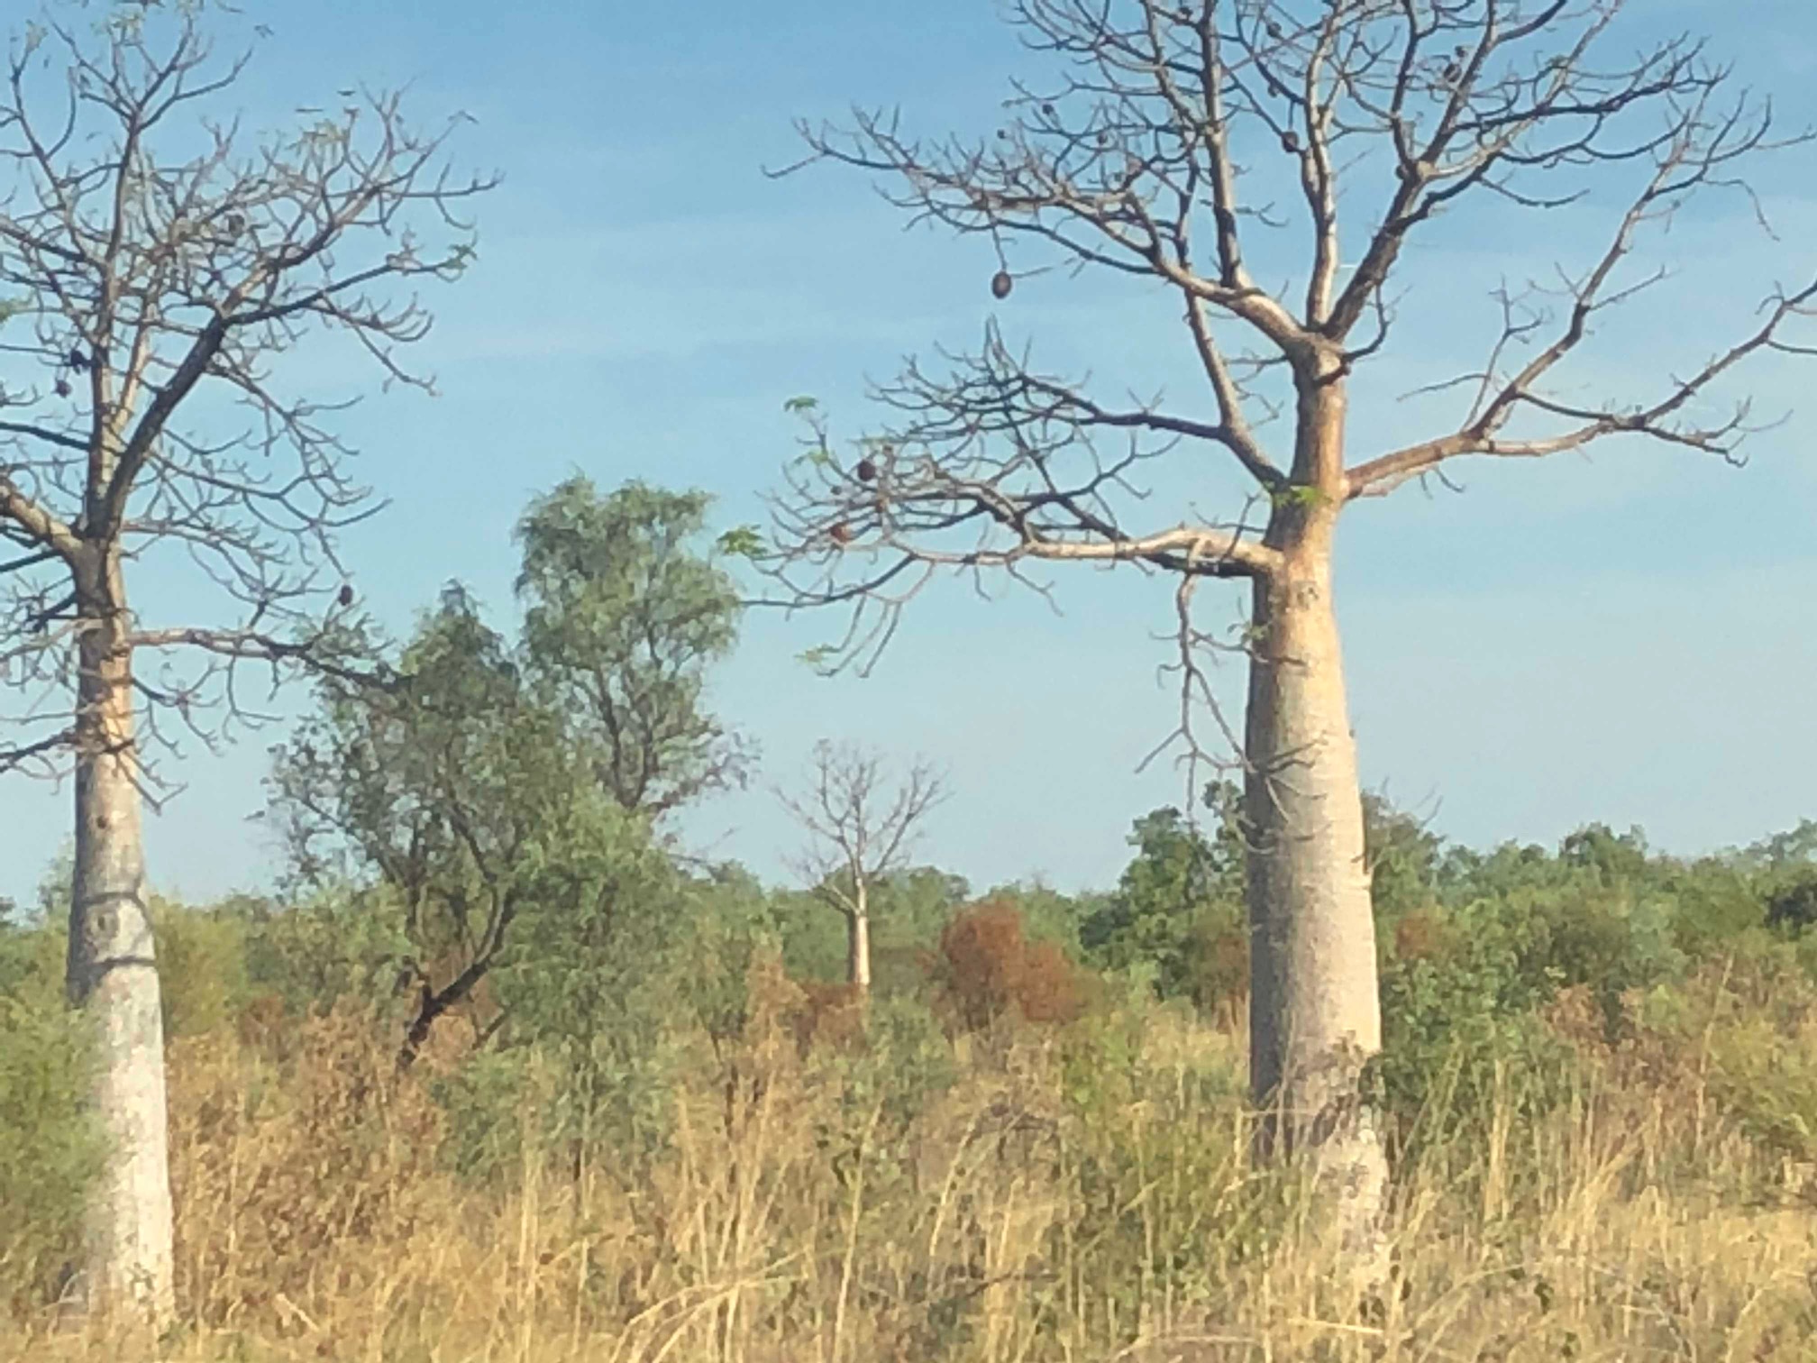
Discussion Questions
Ensuring a Competent Authority reflects Aboriginal and Torres Strait Islander customary laws, and cultural protocols
Suitability to Australian legal and regulatory contexts
Expectations of the functions and powers of the Competent Authority

Slide 28
What do you consider to be the most important features for a Competent Authority?
What existing organisations do you think provide effective models for Aboriginal and Torres Strait Islander interests?
What existing organisations do you think provide ineffective models for Aboriginal and Torres Strait Islander interests?
How should local competent authorities (LCAs) be formed?
Should all employees, officers and councillors be Aboriginal or Torres Strait Islander people?
Ensuring a Competent Authority reflects Aboriginal and Torres Strait Islander customary laws, and cultural protocols

Slide 29
Expectations of the functions and powers of the Competent Authority
Should there be a single national competent authority (NCA)?
Should a NCA carry out the duties of the NCA and the national focal point?

Slide 30
Suitability to Australian legal and regulatory contexts
What form do you think the Competent Authority should take? (for example, an Aboriginal Corporation, statutory body, charitable trust, and how many tiers: local, regional, national?)
How should decision-making within the Competent Authority operate taking into account that the Competent Authority needs to meet criteria under the Nagoya Protocol?
Should the national registrars for men’s business and women’s business databases and registries be able to delegate authority to others in the Competent Authority?

Slide 31
Proposal
A Tiered Approach: local/regional, national
The form of each local/regional authority is for each community to decide
Local/Regional competent authorities should be supported by a national competent authority
Local/Regional competent authorities are not subordinate to the national competent authority but rather assist Indigenous communities to achieve self-determination.

Slide 32
Workshops
Purpose functions and roles of each tier of governance and how those tiers interrelate
Two Laws: Reconciling Indigenous and Western Laws
Identifying relevant governance principles for different tiers of governance

Slide 33
Thank you
Please see our Project page
Garuwanga: Forming a Competent Authority to Protect Indigenous Knowledge
www.indigenousknowledgeforum.org

