Slide 1
Patenting of Plant-Based Resources with Known Māori Uses
A/Prof Daniel Robinson, Dr Jessica Lai, Hai-Yuean Tualima and Dr Tim Stirrup

Slide 2
Introduction and Aims
Identify the use of biological resources and associated Mātauraunga Māori in the patent system.
Identify if Mātauraunga Māori and resources might have been utilised towards patents.
To consider implications for ABS, Mātauraunga Māori and IP regulations, and Māori concerns.
To identify and map which industry fields and countries are most active.

Slide 3
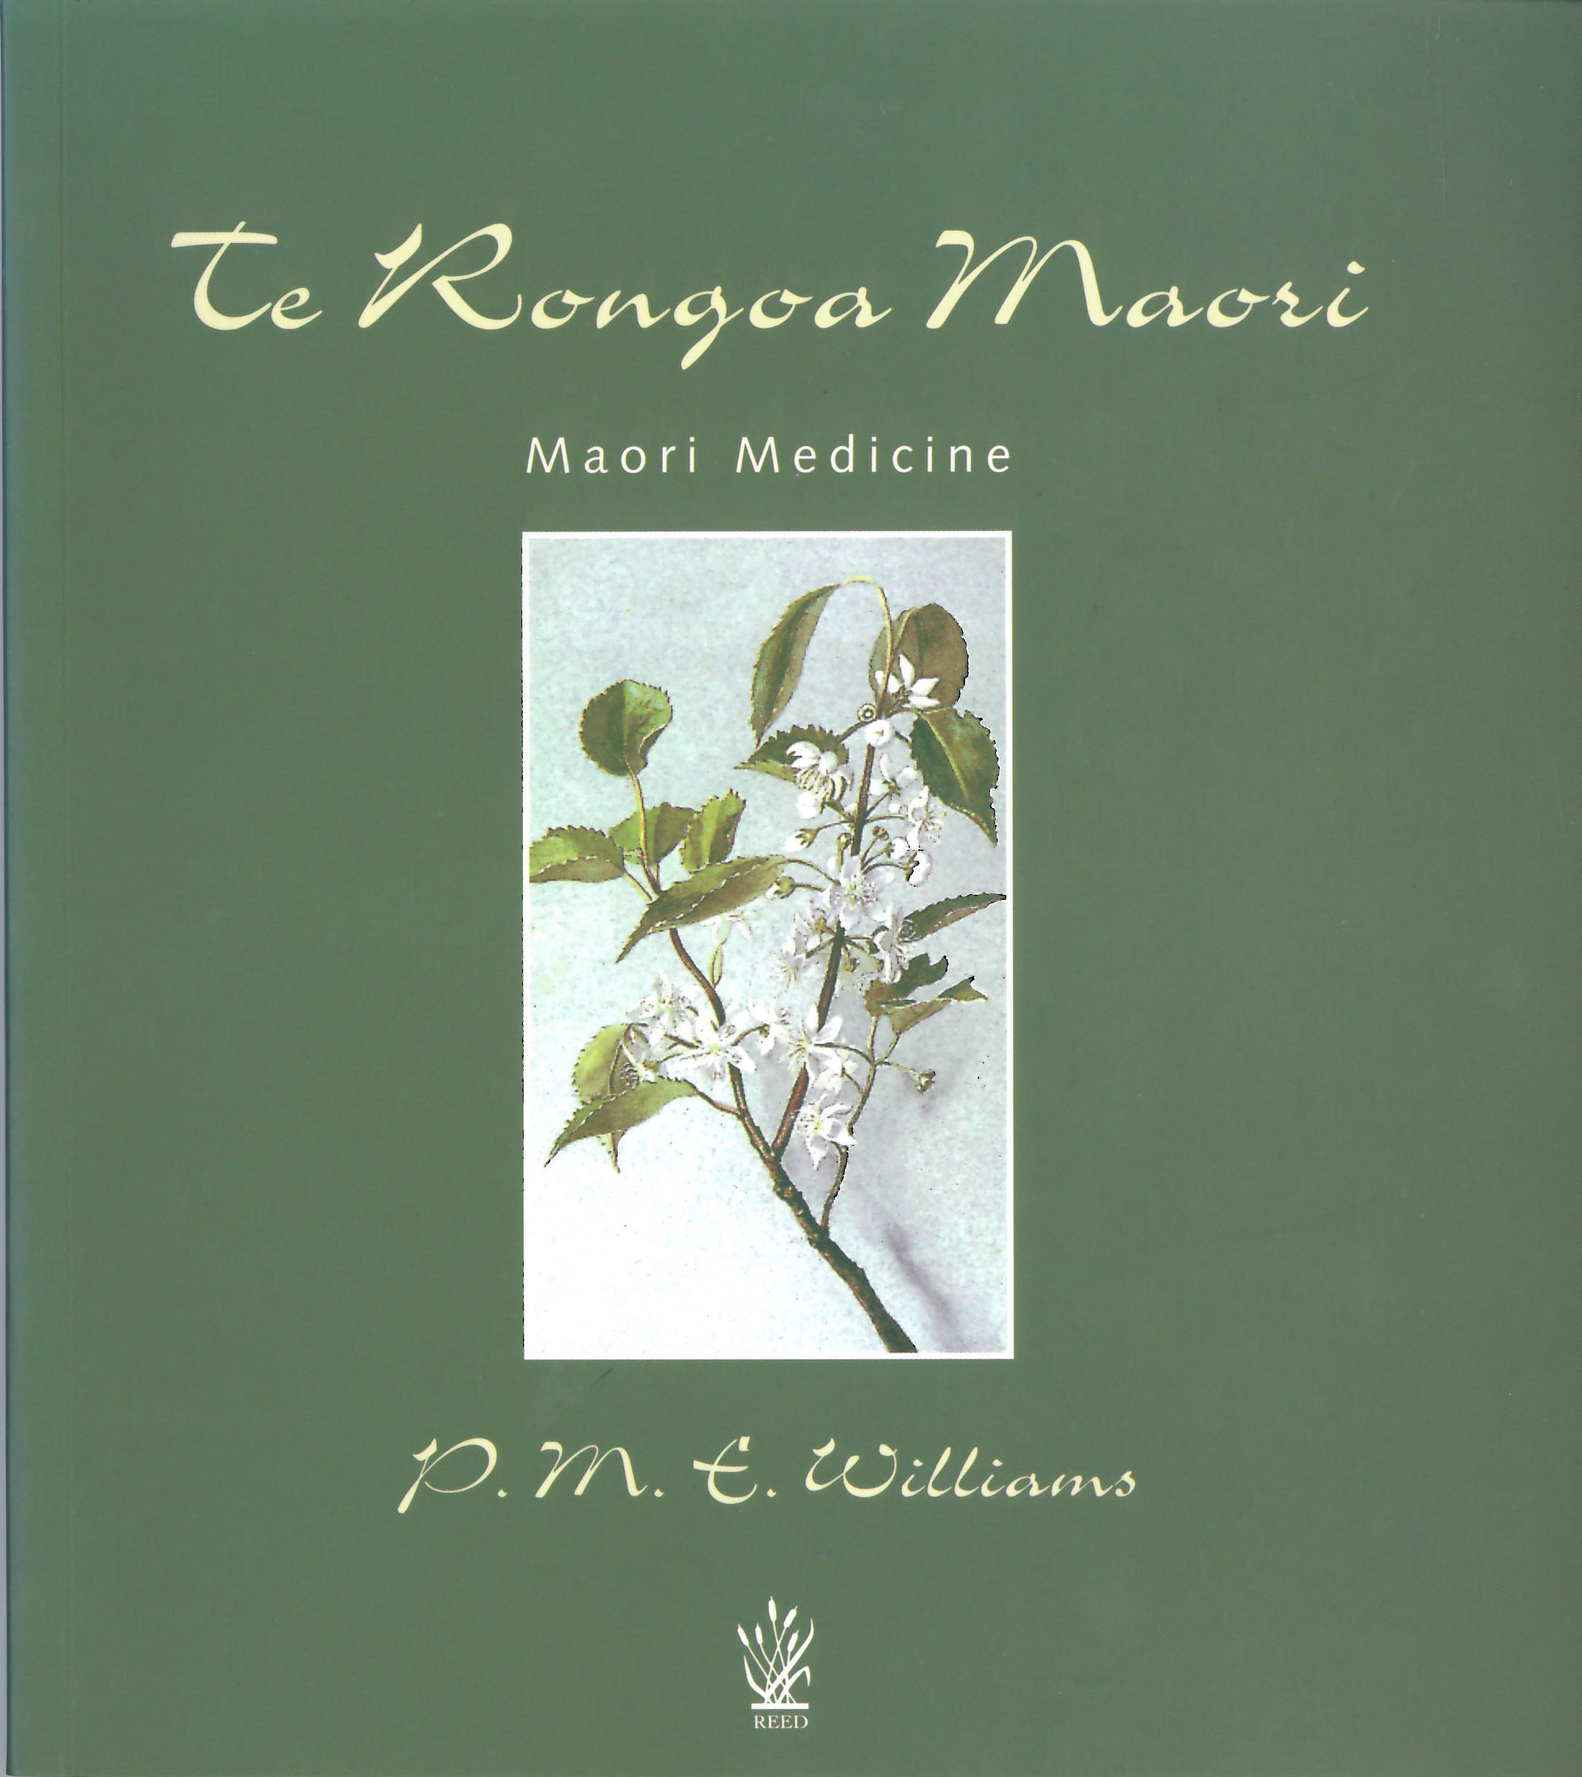
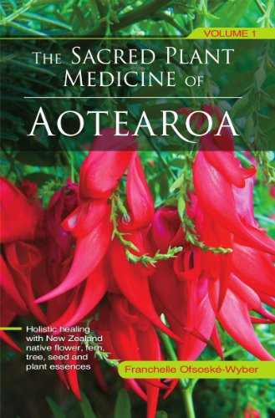
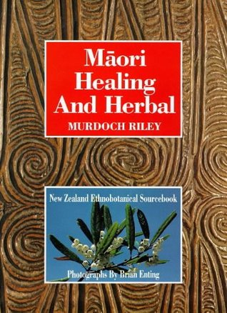
Methods – Texts Used
Identify plants with known Mātauraunga Māori.
Texts used
Williams, P.M.E. (2008) Te Rongoa Maori: Maori Medicine, Raopo Books (Penguin Books), Rosedale NZ, 79pp.
Ofsoske-Wyber, F. (2009) The Sacred Plant Medicine of Aotearoa: The Definitive Reference Book for Working with New Zealand Native Flower, Fern, Tree, Seed and Plant Essences., Volume 1, Vanterra House Pub. 472pp.
Riley, M. (1994) Maori healing and herbal. Viking Sevenseas, Paraparaumu, New Zealand. 528pp
173 species identified
www.firstlightfloweressences.co.nz, acc 25/1/18
Notes:
Use of ethnobotanical/ethno-medical texts focused on Maori IK to identify the potential use of IK towards patents.

Slide 4
Method Flow Chart
List species with documented Mātauranga Māori
Search patent records
(title, abstract or claims)
Filter records for endemic/near endemic species
24 species →
171 patent families
(269 patent applications)
173 species
1972 patent families
(2991 patent applications)

Slide 5
Top 10 Endemic/Near-Endemic Species:
Species Name | Common and/or Māori name | Patent families | Patent Applications | Estimated Distribution
Leptospermum scoparium | Red Manuka, Tea tree | 51 | 161 | NZ and SE Australia
Phormium tenax | Harekeke, native flax | 39 | 47 | NZ , Aust
Tetragonia tetragonioides | Kokihi, NZ Spinach | 19 | 20 | NZ, Aust
Kunzea ericoides | Kanuka, White Manuka | 12 | 31 | NZ, Aust
Podocarpus totara | Totara | 8 | 9 | NZ
Agathis australis | Kauri | 7 | 8 | NZ
Cordyline australis | Ti Kouka (Cabbage tree) | 7 | 10 | NZ, Aust
Pseudowintera colorata | Horopito, Pepper tree | 5 | 8 | NZ
Macropiper excelsum | Kawakawa, Māori Pepper | 3 | 5 | NZ, Norfolk and Lord Howe
Clematis paniculata | Puawananga | 2 | 9 | NZ, Aust
Notes:
So for example one Manuka family has patents filed in 17 different countries

Slide 6
Method Flow Chart
List species with documented Mātauranga Māori
Search patent records
(title, abstract or claims)
Filter records for endemic/near endemic species
ID patents of interest
Categorise patents of interest
(1)
(2)
24 species →
171 patent families
(269 patent applications)
173 species
1970 patent families
(2981 patent applications)

Slide 7
(1) Identifying Patents of Interest
2 criteria for exclusion:
Criterion 1 - Species was mentioned as one of many plant species suitable for the invention
Criterion 2 - Species was a minor ingredient among many combined to make up a composition
Notes:
In this case, the identity of the plant is not really relevant to the monopoly being claimed by the patent applicant

Slide 8
(2) Further Categorisation
Based on published literature and more close examination of patent title, abstract, claims

Slide 9
Preliminary Results: (1) Patents of Interest
Preliminary Results | Less-Preliminary Results
81 → | 77 patent families of interest/concern
12 → | 11 species
156 + 14 → | 148 national filings + 13 WIPO filings
Notes:
4 applications that – upon closer inspection – did not actually claim the species
2 for Manuka
2 for Kauri.

Slide 10
Later discovered not to be endemic/near endemic
Notes:
Unsurprisingly, Manuka is at the top with 33 patents mentioning it

Slide 12
7 of these related to Mānuka
(1 Totara – method of extracting Totarol)
(1 Horopito – method of extracting Polygodial)
Notes:
Totara – No known Maori medicinal use. Totarol is anti-microbial.
Title: A Method Of Extracting Totarol And/or A Product Containing Totarol
NZ No. 530834. Filed 28 Jan 2004, Patent date 22 Apr 2005, Granted 11 Oct 2007.
Horopito - Māori take leaf, chew it, apply to wounds, which heal rapidly, leaving a blue tattoo mark (Harper, quoted in Beattie MS 582/E/11, Hocken).
Polygodial is antimicrobial.
Title: Co2 Extraction Of Polygodial From Horopito
NZ No. 520178, Filed 15 Jul 2002, Patent date 15 Oct 2003, Granted 09 Jun 2005

Slide 13
A Case Study (Lai, 2019)

Slide 14
Leptospermum scoparium (mānuka, red tea tree)
Distribution: NZ and SE Australia
Wood
Leaves
Bark
Honey
Tea and beer
Medicinal:
“Treatment of urinary complaints, fevers, colds, burns, dysentery, skin and muscle inflammations, eye and mouth problems, and for pain relief and as a sedative”
“Ashes of mānuka were rubbed on the scalp to cure dandruff.”
“Leaves were put in a calabash with water and hot stones, and the liquid was drunk to ease a fever.”
“The bark was boiled in water, which was drunk to cure dysentery and diarrhoea.”
Wai 262, 128-131.
Murdoch Riley Maori Healing and Herbal (Viking Sevenseas NZ, 1994).
Te Papa Tongarewa “Manuka & Kanuka” <https://collections.tepapa.govt.nz/topic/2988>.
Rhys Jones “Rongoā – Medicinal use of Plants” Te Ara The Encyclopedia of New Zealand <https://teara.govt.nz/en/rongoa-medicinal-use-of-plants>.
Stanley G Brooker “Economic Native Plants of New Zealand” (1989) 43(1) Economic Botany 79.
Notes:
Especially East Cape of NZ.
Ngati Porou

Slide 15
(1) Patents of Interest
51 patent families
33 families of interest = 88 national filings + 12 WIPO)
(2 x propagation techniques)
(5 x minor ingredient)
(9 x one of many plant species listed as usable)
(2 x Mānuka not part of invention)

Slide 16
Notes:
More than 33, as two were for pharma and cosmetic

Slide 17
Notes:
Of the 33 families of interest.
88 national patent applications
12 WO filings not included

Slide 18
NZ Applications
Applicant | Priority | Title | Status
Coast Biologicals Ltd | NZ | Antimicrobial Composition Comprising Leptospermum Scoparium And Melaleuca Alternifolia Oils | Filed 1998, Granted 2001, Lapsed 2010
Sapporo Holdings | NZ | Nutritionally Balanced Food Or Beverage Product | Filed 2005. Main application abandoned. A child application granted 2012. 4 Child applications abandoned. 1 child application under examination.
Medihoney Pty Ltd | US | Medicinal Compositions Containing Honey | Filed 2007, Opposed, Withdrawn 2014
Manuka Health New Zealand Ltd, Cyclochem Co Ltd | JP | Antimicrobial Compositions | Filed 2009, Granted 2013
Manukamed Ltd | NZ | Anti-inflammatory Proteins And Peptides And Methods Of Preparation And Use Thereof | Filed 2012, Granted 2015
Manukamed Ltd | NZ | A Wound Dressing | Filed 2013. 2 child applications. Parent and one child application abandoned. One child application under examination.
Comvita Ltd | NZ | Marker Compounds Of Leptospermum Honeys And Methods Of Isolation And Assaying Thereof | Filed 2015, Open for Public Inspection
Notes:
Coast Biologicals Limited – NZ Company
Manukamed Ltd – NZ Company
Medihoney Pty Ltd – Was Aus, bought by Comvita (a NZ Company)
Iams Company – US Company, specialising in pet food
Manuka Health New Zealand Ltd – NZ Company
Cyclochem Co Ltd – Japanese Company
There are other NZ patents relating to Manuka that were not found on Patent Lens – limits of patent lens.
Wai 262, at 130: “In New Zealand, patents have been granted for a number of mānuka-related products and processes. These include the use of mānuka in a process for brewing ale ; mānuka extract useful in the treatment and prevention of oral diseases and pathogens ; UMF-fortified honey ; mānuka hair-removal formulation ; and mānuka honey as part of an antibacterial compound.”
Patents 519778, 518044, 533368, 535038, 555191
All take advantage of known uses/applications of manuka and Leptospermum scoparium.

Slide 19
(2) Further Categorisation of 33
Product appears to be similar to or derivative of Maori TK | 11
Method of preparing/treating a plant extract that appears to be similar or derivative of Māori TK | 1
Uses plant isolate as a component and is related to TK. | 14
Based on a natural product. | 4
Isolated compound, protein, gene or molecule | 3

Slide 20
Limits of Methodology & Results
Only as good as the database and search mask.
Books used, published information on TK.
Patent Lens “title, abstract or claims”, GBIF.
Subjective element of determination:
“of interest”, “similar” and “derivative”.
How to use the data?
Extent of analysis, based on patent system vs te ao Māori?
Way forward?
Not possible to conclude on fact-based inquiries:
appropriation (biopiracy) – context important
Lock of novelty/inventive step – evidence based
Notes:
Should we bother to try and identify connection with matauranga Maori when our information is imperfect?
Does it matter that we later found out that a species wasn’t endemic/near endemic?
Is it patronising to over-categorise in “patent lawyer” language?

Slide 21
Implications?
Hopefully helps stimulate discussion about protection of Maori IK.
Limited response by NZ government to the Wai262 and no ratification of Nagoya Protocol
Maori patent advisory committee may be having some deterrent effect
Culturally competent authority idea? Extent of practicable Maori authority/control raised in the Wai262 report

Slide 22
Wai262 text:
There are two basic promises made to Māori in article 2 of the Treaty [of Waitangi]. In the english text, the promise is to protect Māori in the exclusive and undisturbed possession of their properties. In the Māori text, the guarantee is of ‘te tino rangatiratanga o ratou taonga katoa’ – Māori authority and control over all of their treasured things.

Slide 23
Wai262 text:
First, taonga works are covered by the Treaty reference to taonga. Secondly, in this area the Treaty speaks in the Māori text of authority but not necessarily exclusivity. That is, all things being equal, the legal framework should deliver a reasonable measure of kaitiaki control over the use of taonga works and mātauranga Māori. The more difficult question is how far that rangatiratanga authority should go in today’s world and what a reasonable measure of control means in this complex area.

Slide 24
References:
See paper: Lai, J., Robinson, D.F. with Stirrup, T. and Tualima, H-Y. (Forth, 2019) ‘Māori Knowledge under the Microscope: Appropriation and Patenting of Mātauranga Māori and Related Resources’ Journal of World Intellectual Property, Accepted early-view online, issue pending.
Lai, J. (2019) ‘A Successful Recalibration of Patent Law vis-à-vis Mātauranga Māori? A Case Study of Mānuka (Leptospermum Scoparium)’, in Susy Frankel (ed), The Object and Purpose of Intellectual Property (Edward Elgar, forthcoming). Available on SSRN

Slide 25
Does not appears to be similar to or derivative of Mātauraunga Māori.
Appears to be similar to or derivative of Mātauraunga Māori.
Plant patent.
Unable to determine (due to lack of information, e.g. not in English).

Slide 26
(0) Does not appear to be similar to or derivative of Maori TK and invention is not limited to use of a natural product endemic/near-endemic to NZ.
(1) Appears to be similar to or derivative of Maori TK.
(2) Plant patent.
(3) Unable to determine (due to lack of information, e.g. not in English).
(4) Invention is based on a natural product endemic/near-endemic to NZ.
(5) Invention includes plant extract or isolated compound from a plant endemic/near-endemic to NZ as a minor part of a composition where minor part has potential TK.
(6) Patent claims an isolated compound/protein/gene/molecule from a NZ endemic/near-endemic plant
(7) Incorrectly identified as having the species in the title, abstract or claims.
(8) Invention is a method of preparing/treating a plant extract from an NZ endemic/near-endemic plant.
(9) Invention is a method of preparing/treating a plant extract from an NZ endemic/near-endemic plant that appears to be similar or derivative of Māori TK.

